Slide 1

The W3C Linked Building Data Community Group
Presenters:
Pieter Pauwels, Ghent University (current co-chair)
Kris McGlinn, Trinity College Dublin (current co-chair)
Maxime Lefrançois, MINES Saint-Etienne
Mads Holten Rasmussen, Niras
Ana Roxin, U. Bourgogne

Slide 2
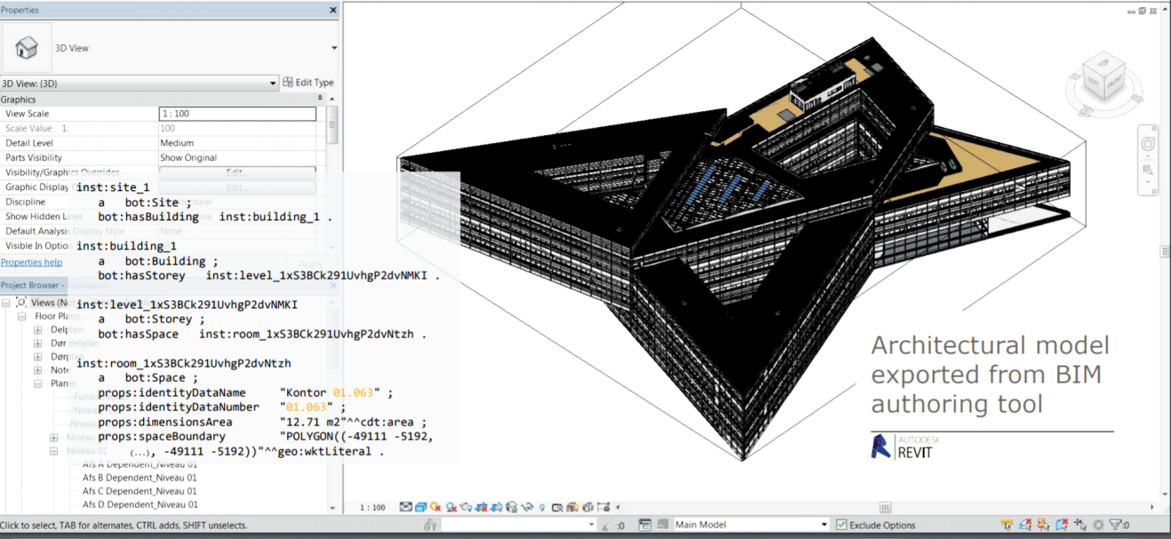
Building Information Modelling (BIM)

Slide 3
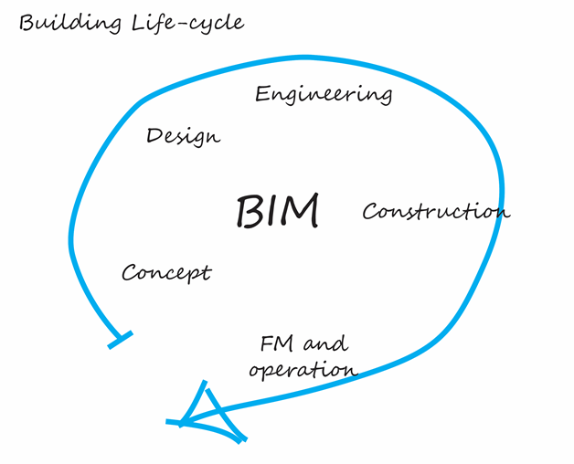
Building Life Cycle

Slide 4
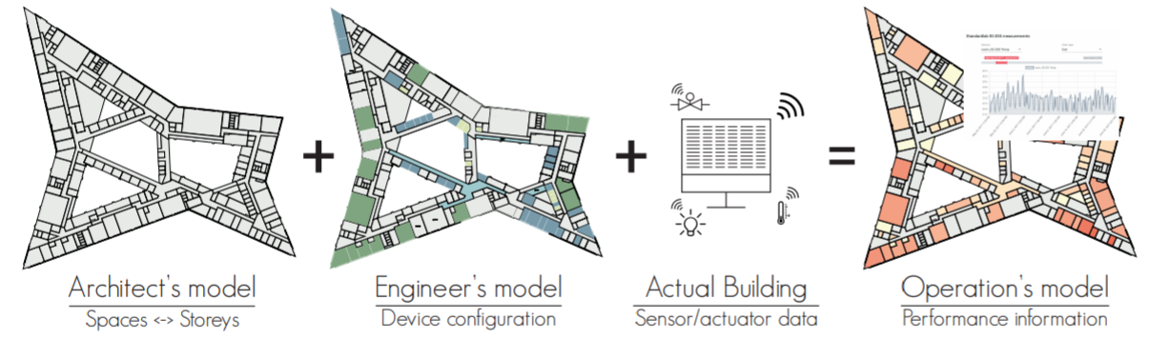
Building Life Cycle

Slide 5
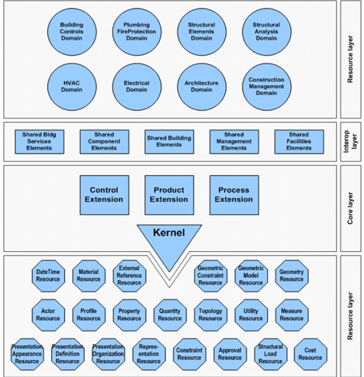
Industry Foundation Classes (IFC)
There exists a standard, but:
not modular
not extensible
not simple enough to use
AND not Web-compliant !

Slide 6
OUTLINE
Who we are
What is our mission
What we produce
Where we head at (and who supports us)

Slide 7
WHO WE ARE

Slide 8
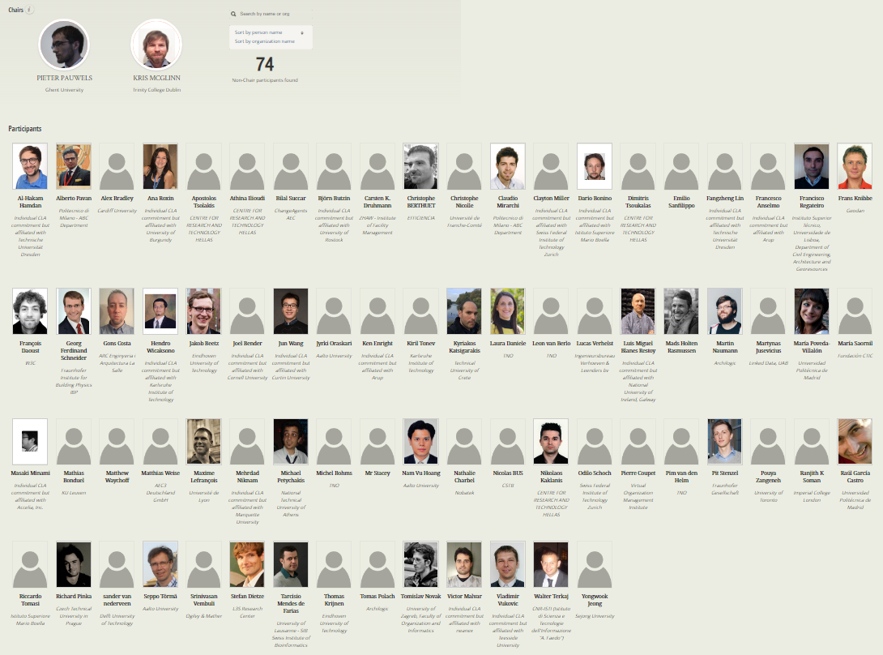
Who we are
started Dec. 2014 now 76 participants

Slide 9
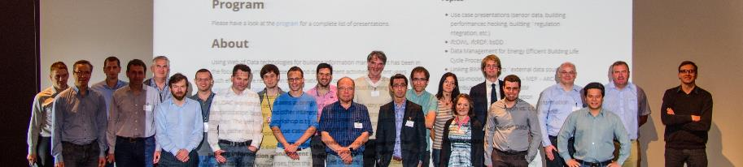
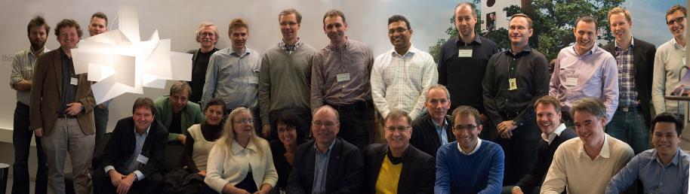
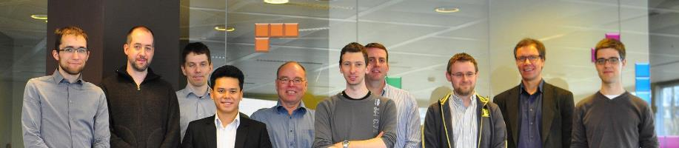
LDAC 2015
LDAC 2014
LDAC 2012

Slide 10
How we work
Public mailing list
Regular online calls (every 2 weeks approx.), minutes public, joint note-taking
Public GitHub organisation https://github.com/w3c-lbd-cg
LDAC Workshop series (6 editions)
Collaborations with other groups and initiatives : BuildingSMART, ETSI SAREF, OGC, AFNOR, CEN, ISO => these need to be made explicit liaisons (MOU to be signed)
External site: https://www.w3.org/community/lbd/
Internal site: https://w3c-lbd-cg.github.io/lbd

Slide 11
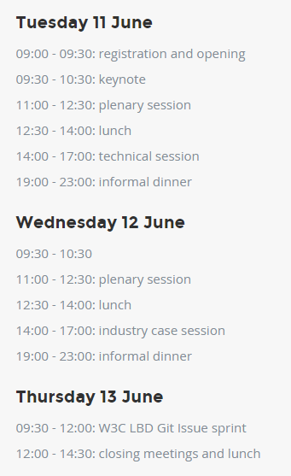
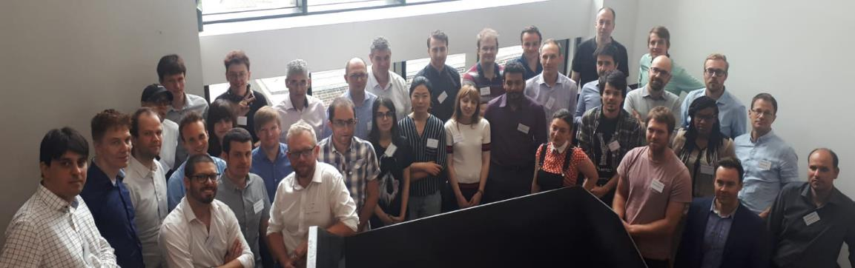


LDAC Workshop 2018
Keynotes

Slide 12
WHAT IS OUR MISSION
Bring together experts in the area of Building Information Modeling (BIM) and Web of Data technologies to:
define existing and future use cases and requirements for Linked Data based applications across the life cycle of buildings.
discuss best practices for publishing building data on the Web
propose ontology models to describe:
Buildings and building elements (topology, associate values to properties)
Products and product properties
discuss how they can be used together with other specifications:
existing standards (IFC, GeoSPARQL, Semantic Sensor Network, ...)
separate initiatives (schema.org, Haystack, BRICK, ...)

Slide 13
WHAT IS NOT OUR MISSION
Out of scope:
description of the geometry
description of the geospatial data
infrastructures (bridges, roads, tunnels, rail, …)

Slide 14
WHAT WE PRODUCE
We actually do work ;)

Slide 15
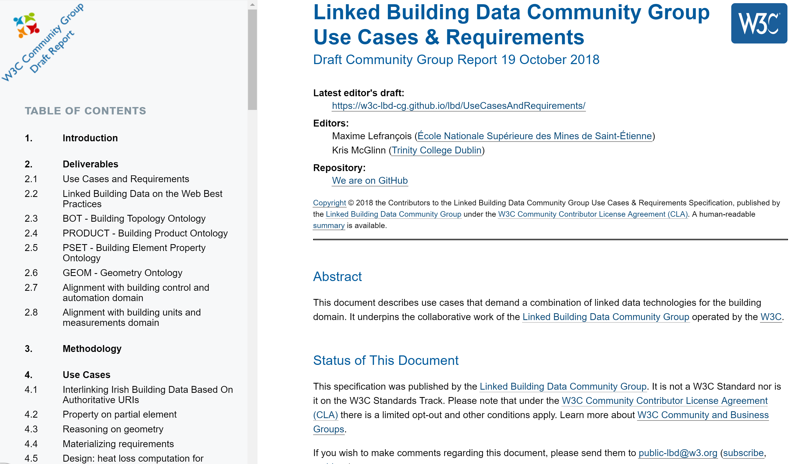
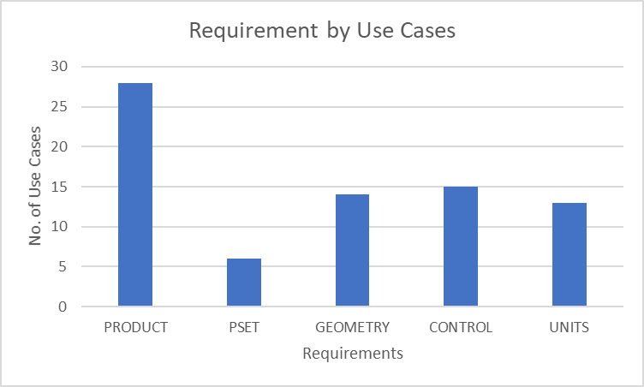
Comprehensive use case gathering is conducted across the LBD community, and also wider research and industrial communities (as part of the h2020 SWIMing project)
Used to identify deliverables and their scope in the charter
Currently 54 use cases, 7 requirements

Slide 16
overview of the structure of the document
(at https://w3c-lbd-cg.github.io/lbd/UseCasesAndRequirements/ )
Comprehensive use case gathering is conducted across the LBD community, and also wider research and industrial communities (as part of the h2020 SWIMing project)
Used to identify deliverables and their scope in the charter
Currently 54 use cases, 7 requirements

Slide 17

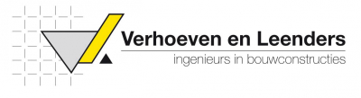










Use cases in practice
Further to these use cases, we strongly support and encourage active practitioners to perform reference implementations and active tests.

Slide 18
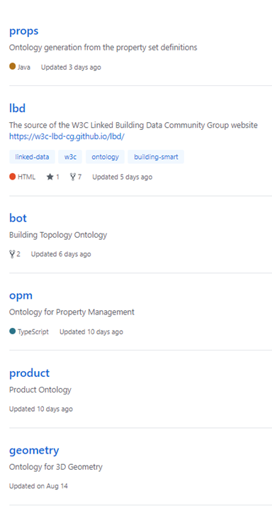
Key ontologies
Project Ontology
Building Topology Ontology (BOT)
Product Ontology (PRODUCT)
Properties Ontology (PROPS)
Geometry Ontology (GEOM)
Ontology for Property Management (OPM)

Slide 19
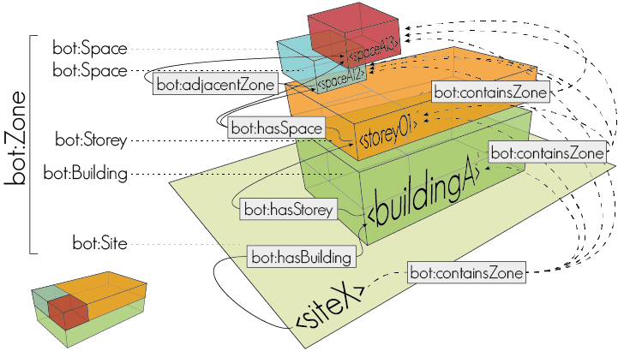
Building topology ontology

Slide 20
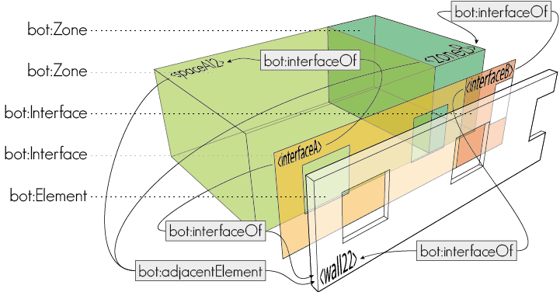
Building topology ontology

Slide 21
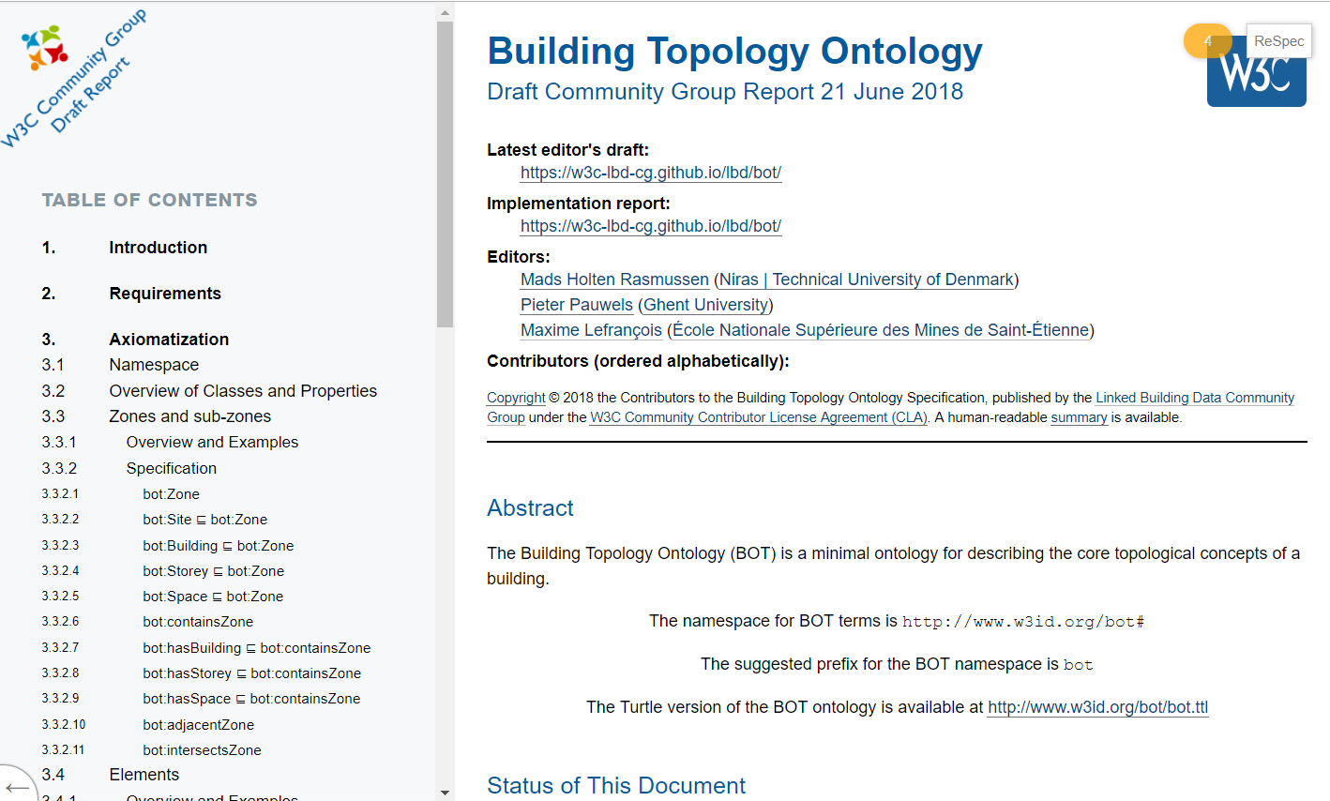
BUILDING TOPOLOGY ONTOLOGY
overview of the structure of the document (at https://w3c-lbd-cg.github.io/bot )

Slide 22
Questions? (5 mins)

Slide 23
WHAT WE PRODUCE
We actually do work ;)

Slide 24
FEATURE OF INTEREST – Property - value
Not only the Building domain describes FoI - Property - Value
W3C standards and initiatives
SOSA/SSN
WoT TD
Automotive WG
External standards
ETSI SAREF
schema.org
BSDD
relevant also outside the building domain
not always RDF

Slide 25
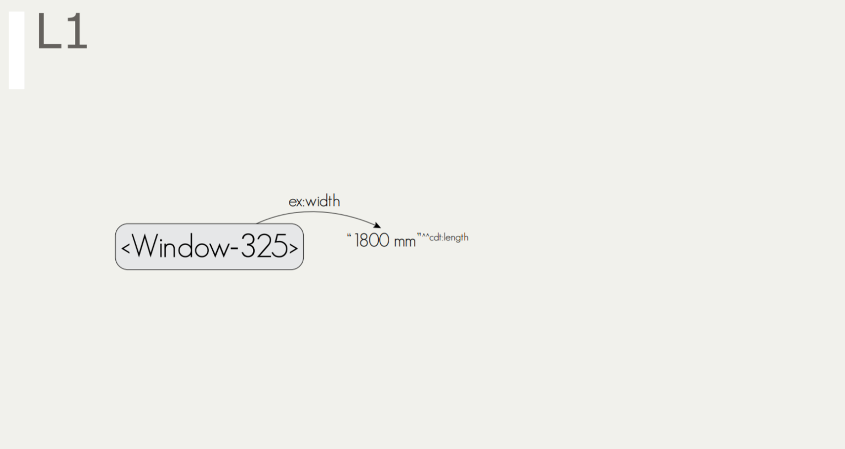
FEATURE OF INTEREST – Property - value

Slide 26

CDT: Custom Datatypes
cdt:ucum is not a product of the group, no discussions to endorse it, but useful
(https://w3id.org/lindt/custom_datatypes#ucum)
"20.7 Cel"^^cdt:ucum
“68.4 %"^^cdt:ucum
"450 lm"^^cdt:ucum
"27.1 ug.m-3"^^cdt:ucum
"142 [ppm]"^^cdt:ucum
"276 W"^^cdt:ucum
"1013.25 hPa"^^cdt:ucum
"1.01325e5 Pa"^^cdt:ucum
"102 m2"^^cdt:ucum
“52 a"^^cdt:ucum
"0.27 W/(m2.K)"^^cdt:ucum
"33 cL"^^cdt:ucum
"0.7 L"^^cdt:ucum
"0 [mi_i]/h"^^cdt:ucum
"0 m.s-1"^^cdt:ucum
"0 km/h"^^cdt:ucum
"4.31 bar"^^cdt:ucum
Figure 1. Two cdt:ucum adopters sitting at a table
@prefix cdt: <http://w3id.org/lindt/custom_datatypes#>.

Slide 27
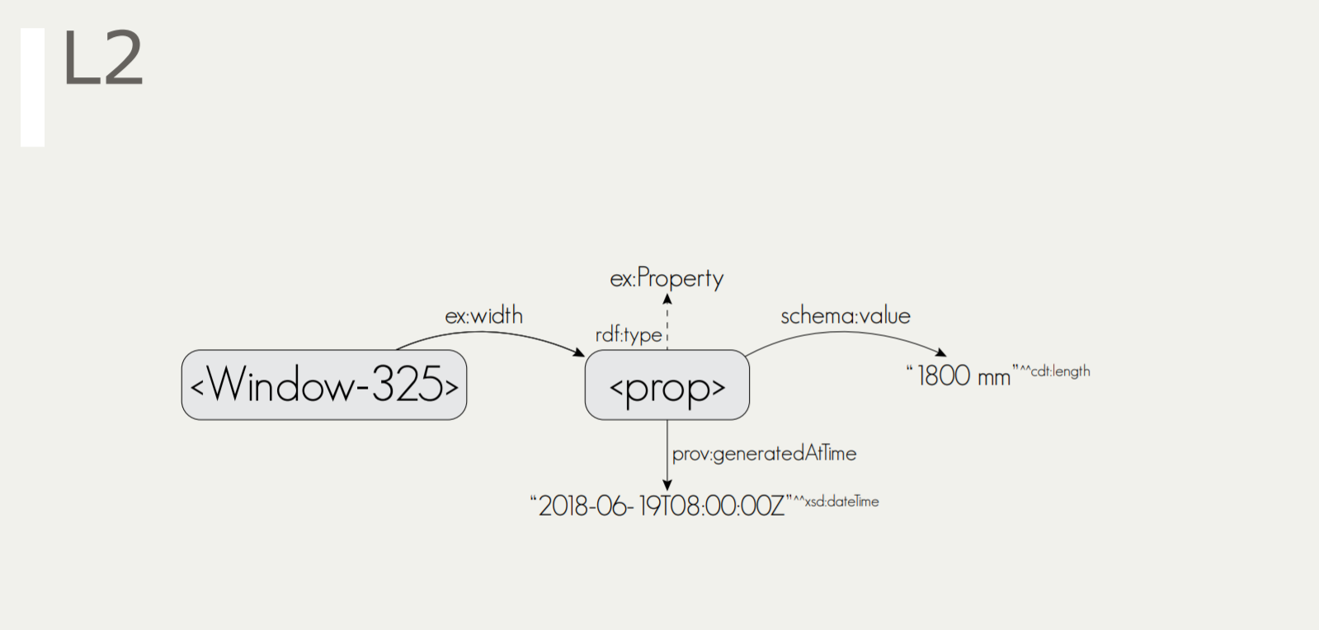
FEATURE OF INTEREST – Property - value

Slide 28
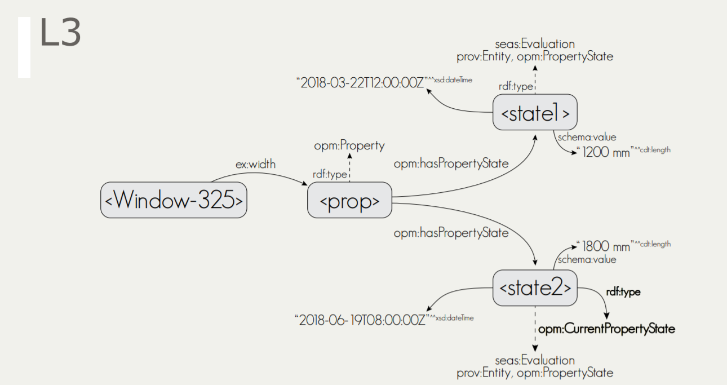
FEATURE OF INTEREST – Property - value

Slide 29
FEATURE OF INTEREST – Property - value
Questions:
Equivalences?
Inference / entailment regime?
Support in RDFS / OWL 2 profiles?

Slide 30
PRODUCTS & PROPERTY EVALUATION
Individual products * (with serial number)
Generic Product *
Manufacturer Products *
Product category
Product placeholder
* also in schema.org
Observation *
Actuation *
Measured Value
Desired Value
Computed Value
Rated Operating Value
…
* also in W3C SOSA/SSN

Slide 31
PRODUCTS & PROPERTY EVALUATION
Reasoning with Products and their properties:
Some use cases require the value of a property of a generic product can be inherited / overridden by a specific product
Validating Products and their properties:
Some use cases require to be able to check conformance of products with respect to requirements

Slide 32
THE overall FoI – product – props model
Domain-independent
Aimed to be a W3C Recommendation
Supported by W3C Group Notes that show domain-specific example taxonomies (see next slides)
All to be documented in the Building Data on the Web Best Practices

Slide 33
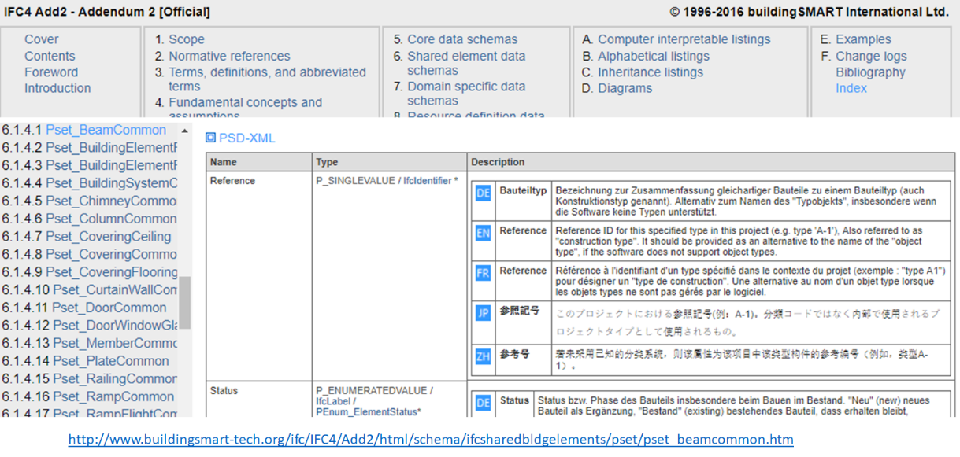
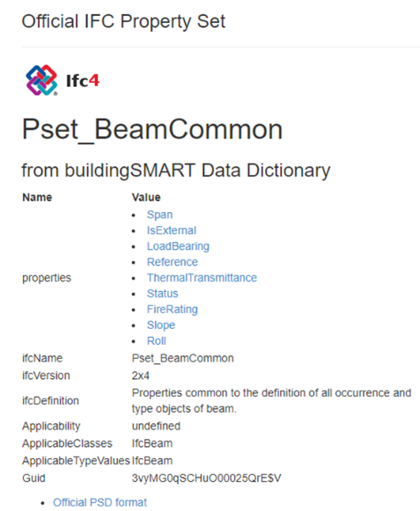
Need for domain-specific taxonomies
We are the linked <building> data group
e.g. CCS, SfB, BuildingElements in IFC, …

Slide 34
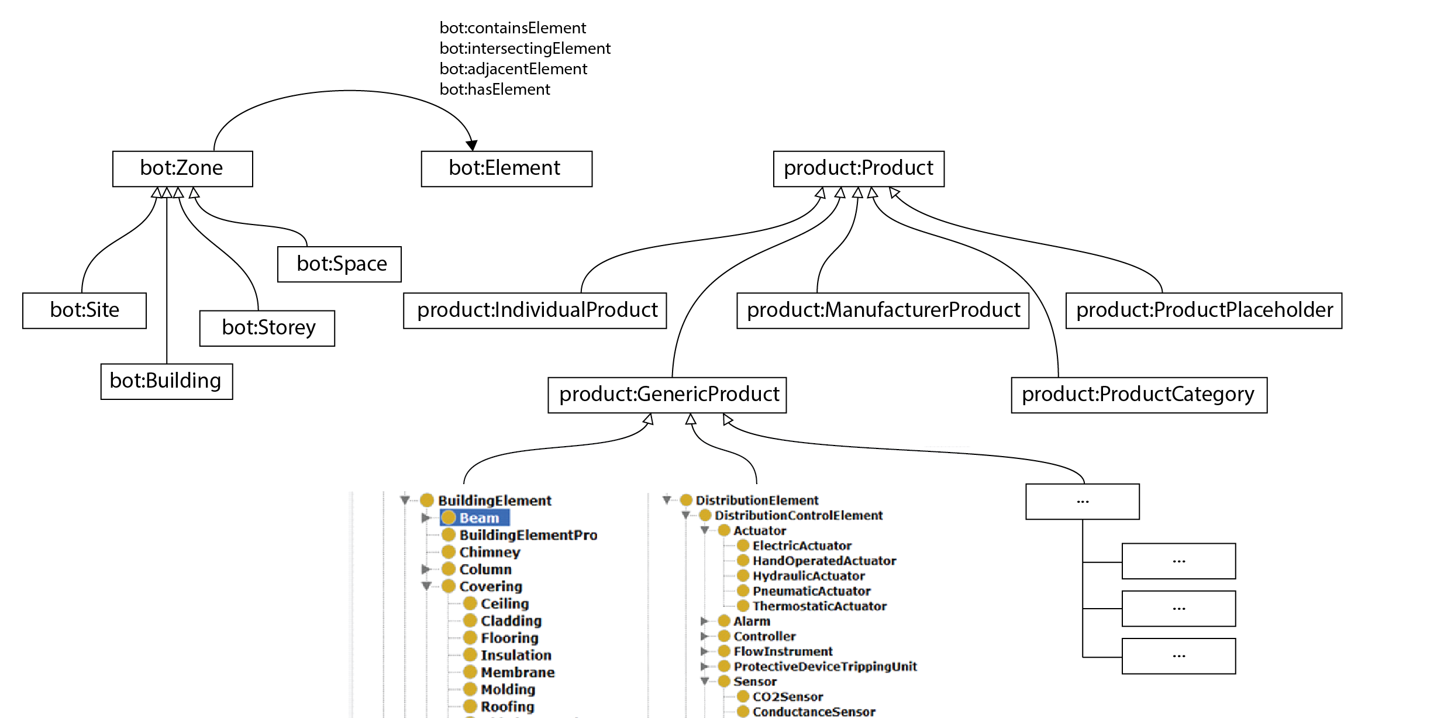
OVERALL STRUCTURE
GoodRelations
inst:Wall_X
Schema.org
rdf:type
rdf:type
geom
geo

Slide 35
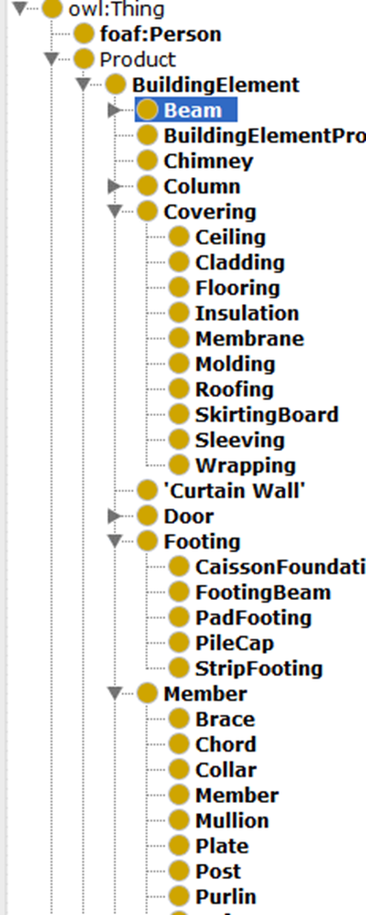
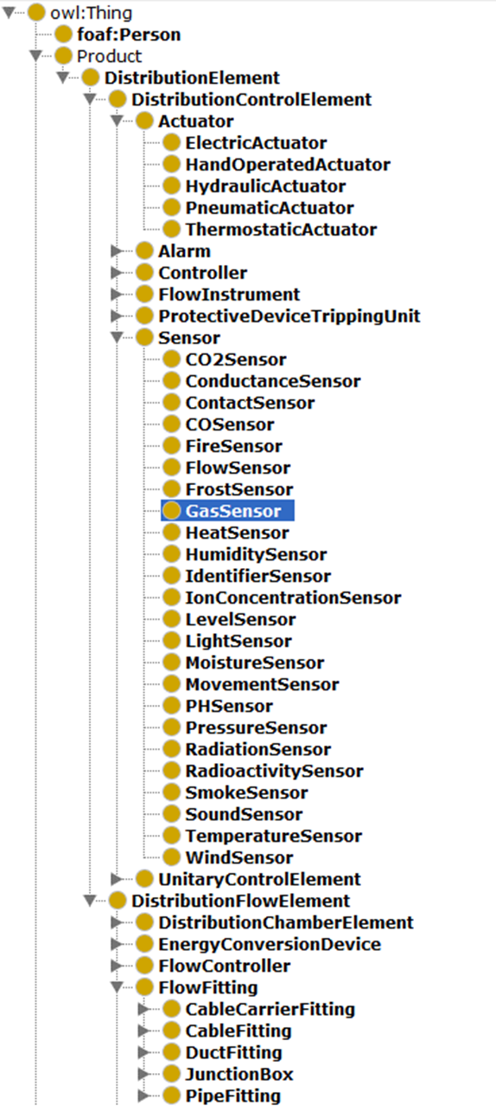
Example taxonomy: IfcProduct ontology

Slide 36
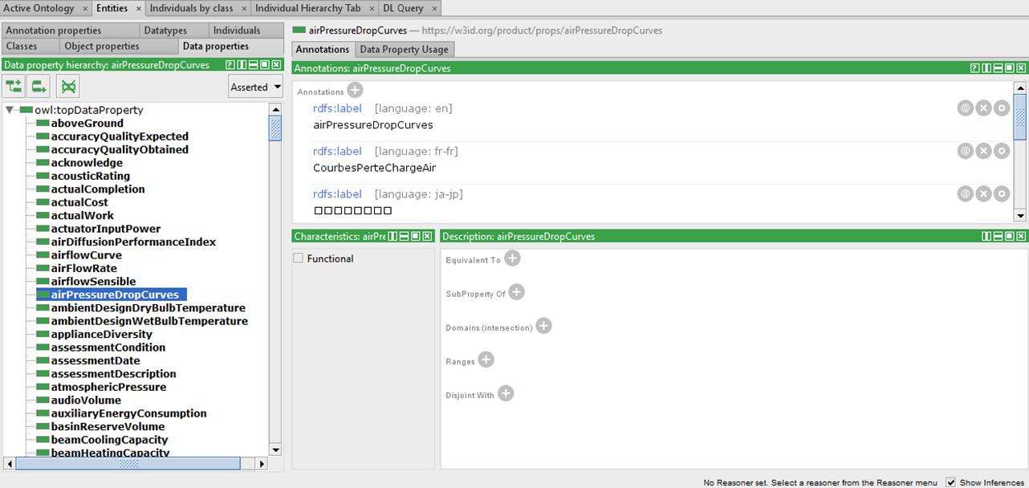
EXAMPLE TAXONOMY: ifcProps ontology

Slide 37
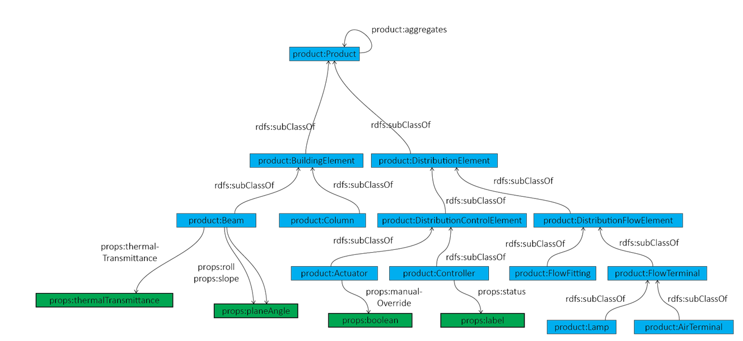
Links between the IFCPROPS and IFCPRODUCT ontology

Slide 38
Questions? (5 mins)

Slide 39
Alignments and Links
We don't use the close world assumption ;-)

Slide 40




Existing Vocabularies/Standards for Building Data
W3C | buildingSmart International | OGC | ISO | Other
SSN (Semantic Sensor Networks) | ifcOWL | GML (Geography Markup Language) -> ISO 19136:2015 | Data structures for electronic product catalogues for building services -- Part 1: Concepts, architecture and model (ISO 16757-1:2015) | DogONT (Ontology Modeling for Intelligent Domotic Environments)
owl-time | ISO 29481 Building information models -- Information delivery manual (IDM) | CityGML | Geographic Information - Spatial Schema (ISO 19107:2003) | FIEMSER and SAREF (Smart Appliance REFerence Ontology) and its extensions
JSON-LD (JavaScript Object Notation for Linked Data) | ISO 12006 Building construction -- Organization of information about construction works | CityGML Building Module | OWL representation of part of the model for geometry and space from ISO 19107:2003 (ISO 19150-2) | Ontology of Spatial Relations (defined by the UK Ordnance Survey)
BasicGeo | ISO 12006-2 Framework for classification | GeoSPARQL |  | GeoVocab Geometry and Spatial Ontology
SOSA (Sensor, Observation, Sample, and Actuator) ontology | ISO 12006-3 Framework for object-oriented information (IFD) | Indoor GML |  | SmartEnergy Aware Systems (SEAS)
 | Industry Foundation Classes (ISO 16739:2013) | SensorML (OpenGIS Sensor Model Language) |  | Brick
 |  | SWE (Sensor Web Enablement) Common Data Model |  | Project Haystack
Notes:
http://schemas.opengis.net/

Slide 41
What is an alignment ?
Aligning = bring into line
In the context of the Semantic Web community, aligning 2 vocabularies/ontologies means that for each element (class, relation, instance) in vocabulary A one must find a corresponding resource (having the same indented meaning) in vocabulary B
Alignments can be defined at several levels:
Data layer – by comparing data values of simple/complex datatypes
Ontology layer – by considering semantic relations among resources
Context layer – by taking into account resources’ application context
Alignments can be specified in several manners:
Directly in the vocabulary/ontology TBox
As separate linksets, one can choose to import

Slide 42
Alignments for BOT (by Georg Ferdinand Schneider)
Outgoing links
Incoming links
BOT Resource URI | Predicate | Aligned Resource URI
bot:Zone | rdfs:subClassOf | brick:Location
bot:Zone | rdfs:subClassOf | dogont:Environement
“The Building Topology Ontology (BOT) is a simple ontology defining the core concepts of a building.”
Aligned Resource URI | Predicate | BOT Resource URI
brick:Building, dogont:Building, dogont:Flat, ifc:IfcBuilding, rooms:Building | rdfs:subClassOf | bot:Building
brick:Equipment, brick:Point, dogont:Controllable, dogont:Device, dogont:UnControllable, dogont:TechnicalSystem ifc:IfcElement, rooms:Desk | rdfs:subClassOf | bot:Element
ifc:IfcSite, rooms:Site | rdfs:subClassOf | bot:Site
brick:Basement, brick:Outside, brick:Room, brick:Space, brick:Wing, brick:Zone, dogont:Room, ifc:IfcSpace, rooms:Room | rdfs:subClassOf | bot:Space
brick:Floor, dogont:Storey, ifc:BuildingStorey, rooms:Floor, rooms:FloorSection | rdfs:subClassOf | bot:Storey
dogont:BuildingEnvironement | rdfs:subClassOf | bot:Zone
brick:contains | rdfs:subPropertyOf | bot:containsElement
dogont:hasWallOpening | rdfs:subPropertyOf | bot:hosts
rooms:contains | rdfs:subPropertyOf | bot:containsZone
bot: https://w3id.org/bot#
brick: https://brickschema.org/schema/1.0.2/Brick#
dogont: http://elite.polito.it/ontologies/dogont.owl#
ifc: http://www.buildingsmart-tech.org/ifcOWL/IFC4_ADD2#
rdfs: http://www.w3.org/2000/01/rdf-schema#
rooms: http://vocab.deri.ie/rooms#

Slide 43
Alignments for Product Ontology (by Georg Ferdinand Schneider)
Outgoing links
PRODUCT Resource | Predicate | Aligned Resource
product:Wall | owl:equivalentClass | ifc:IfcWall
product:Window | owl:equivalentClass | ifc:IfcWindow
product:Door | owl:equivalentClass | ifc:IfcDoor
product:Beam | owl:equivalentClass | ifc:IfcBeam
product:Chimney | owl:equivalentClass | ifc:IfcChimney
product:Column | owl:equivalentClass | ifc:IfcColumn
product:CurtainWall | owl:equivalentClass | ifc:IfcCurtainWall
product:Slab | owl:equivalentClass | ifc:IfcSlab
product:Railing | owl:equivalentClass | ifc:IfcRailing
product:Ramp | owl:equivalentClass | ifc:IfcRamp
product:Roof | owl:equivalentClass | ifc:IfcRoof
product:ShadingDevice | owl:equivalentClass | ifc:IfcShaddingDevice
product:Stair | owl:equivalentClass | ifc:IfcStair
“The PRODUCT Ontology (PRODUCT) extends the Building Topology Ontology (BOT) with more specific building elements.”
ifc: http://www.buildingsmart-tech.org/ifcOWL/IFC4_ADD2#
product: https://w3id.org/product#

Slide 44
LINKING GEOSPATIAL & GEOMETRY TO BOT
Geometry is an important part of BIM
Many different types of geometry, with different standards to meet the requirements of different use cases
No approach or standard is generally superior to others.
BOT provides a simplified (compared with other available standards, e.g. IFC) method for interlinking non-geometric data with multiple geometry representations, to address use cases.
GIS Application
CAD Application
CAD Application
Export
2D Geospatial
Geometry
3D Geometry
(Simplified Tessellated)
3D Geometry
(Detailed Semantic)
Import
Use Case 3
Use Case 1
Use Case 2

Slide 45
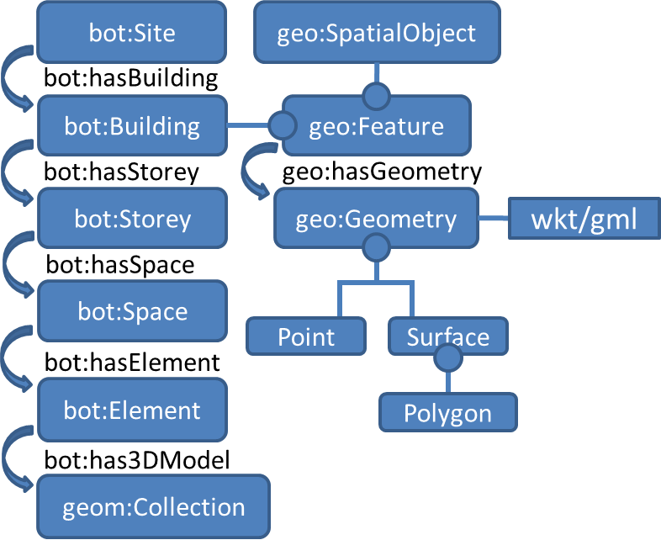
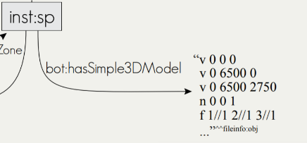
LINKING geospatial & GEOMETRY TO BOT
For Simple geolocation
bot:hasZeroPoint links to wsg84:Point
For 2D geospatial data
bot:Building is a subclass of geo:Feature, and can have geometry, which can be expressed as GeoSPARQL WKT.
For 3D geometry
bot:hasSimple3DModel links to a literal that encodes 3D geometry (e.g., OBJ model) bot:has3DModel links to a blank node or IRI that further describes the 3D geometry with another vocabulary (e.g., the Geom ontology - http://rdf.bg/geometry.ttl )

Slide 46
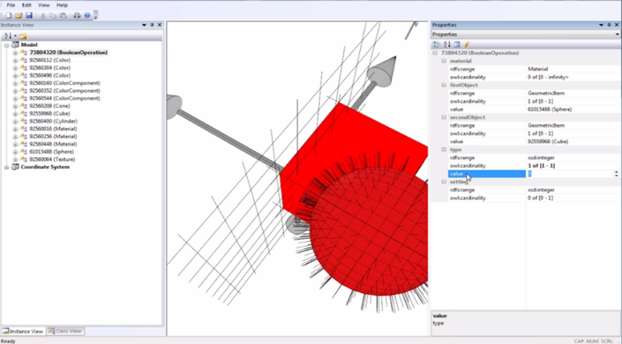
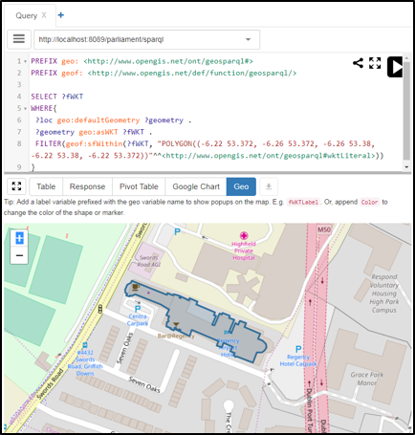
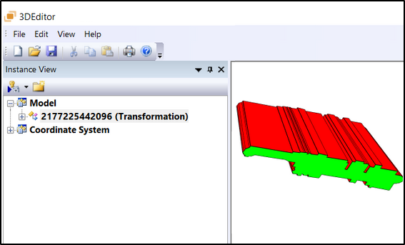
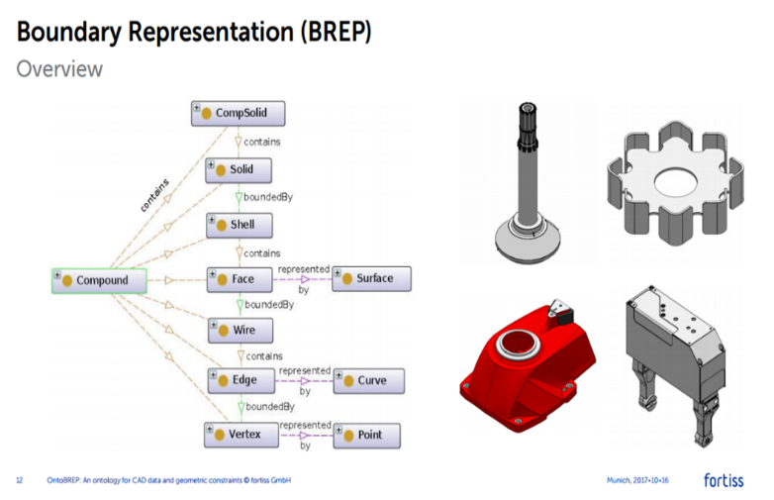
External ontologies for 2D & 3D geometry
Geom – 2.5D & 3D
OntoBREP
- 3D
GeoSPARQL – 2D Geospatial

Slide 47
Future Work (best practices)
Encouraging sharing across weakly or uncoupled communities
Define links between the vocabularies conceived and what exists
Define a publication approach
Stop reinventing the wheel – ease of understanding and modularity
Publish the linked vocabularies, as interlinked modules with human-readable annotations
Following the latest DCAT W3C vocabulary
Mapping between different vocabularies
Decide which approach
Using "upper ontologies" with very general terms that are applicable to the different communities.
Using rules that define how terms in the different vocabularies relate to each other in specific contexts.
Publish the links so their re-use gets maximized
Linksets (e.g. *.ttl files) – “RDF is often seen as too complex and finding simplifications would be helpful for wider adoption”[1]
Rules – “Converging on a simple, sufficient rules language would be very helpful” [1]
SPARQL endpoints and support for SPARQL 1.1 Query Language Specification
[1] W3C study of practices and tooling for Web data standardization, by Dave Raggett, W3C Data Activity Lead, December 2017, available online: https://www.w3.org/2017/12/odi-study/

Slide 48
Questions? (5 mins)

Slide 49
LIAISONS
Looking for collaborations and integration outside our group

Slide 50
Links to other W3C groups
W3C
Interest Groups
Automotive
(V2Building?)
Data Exchange
Schema.org
Automotive ontology
Blockchain
Community Groups
Dataset Exchange
Web of Things
Working Groups
Web of Things
Spatial Data on the Web
Notes:
https://www.w3.org/2017/12/odi-study/#rdf
CSVW - https://www.w3.org/community/csvw/
Devices and Sensors WG
https://www.w3.org/das/roadmap
Web of Things
WoT & OGC Sensorthings API
JSON-LD
Spatial Data on the Web IG
CityJSON
CovJSON
SSN extensions
SSN / SOSA
Web of Things IG

Slide 51
Links to existing Standardisation Groups
ISO/DIS 21597 Information Container for Data Drop
ISO/DIS 23262 GIS and BIM interoperability
buildingSmart Data Dictionary (bSDD)
Linked Data Working Group (LDWG)
French national plan for buildings’ digital transition
Dictionary of properties
CEN TC 442 Building Information Modelling – WG4 Support Data Dictionaries
ETSI – Smart Appliances Reference ontology (SAREF)
American Society of Heating, Refrigerating and Air-Conditioning Engineers BRICK - http://brickschema.org
Notes:
four of the main developers of SAREF are members of LBD-CG

Slide 52

TPAC 2016
Lissabon
TPAC 2018
Lyon
Toronto ITM October 2014
Watford ITM March
2015
Singapore ITM October 2015
Rotterdam ISM April 2016
Korea ISM September 2016
Barcelona ISM March 2017
London ISM October 2017
New York TechRoom February 2018
Paris ISM March 2018
SWIMing VoCamp 2016
Dublin
SWIMing VoCamp 2016
London
SDW IG F2F
Online
June 2018
LDAC 2014
Helsinki
LDAC 2015
Eindhoven
LDAC 2016
Madrid
LDAC 2017
Dijon
LDAC 2018
London

Slide 53
Questions? (5 mins)

Slide 54
IMPLEMENTATIONS
Why it's worth for the industry

Slide 55
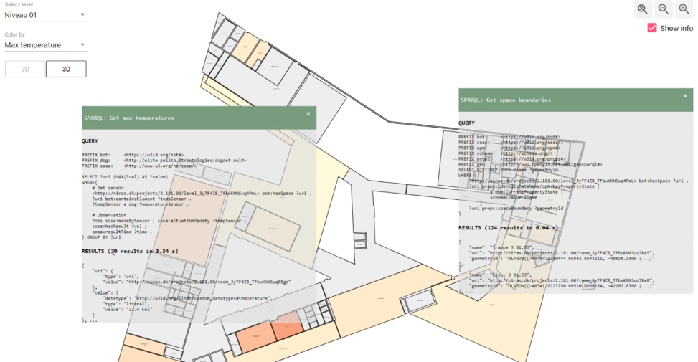
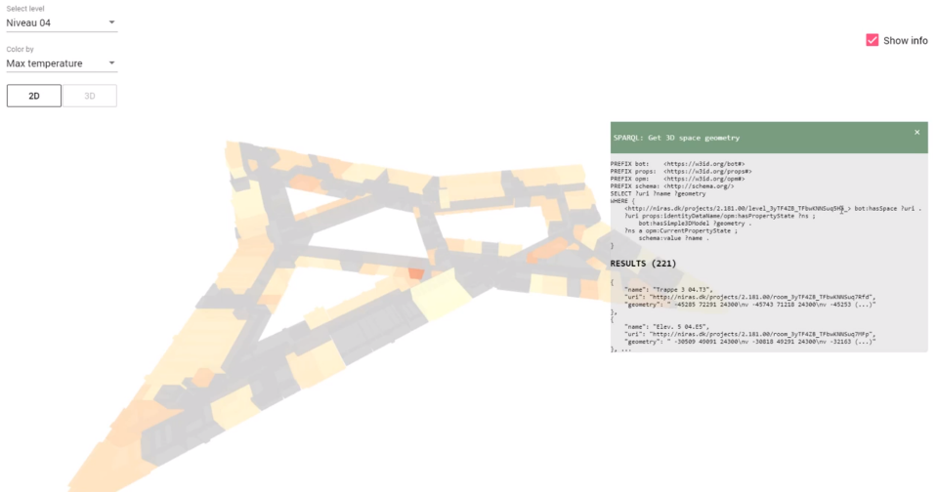
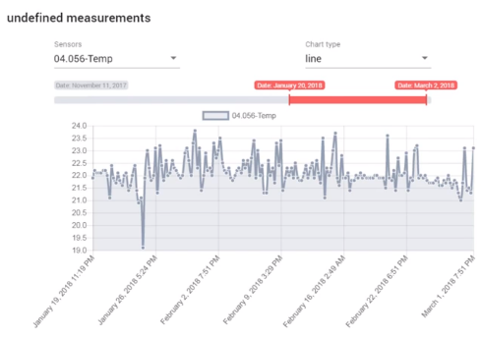
BOT + SOSA + geometry
https://youtu.be/P_38gIvrbmg

Slide 56
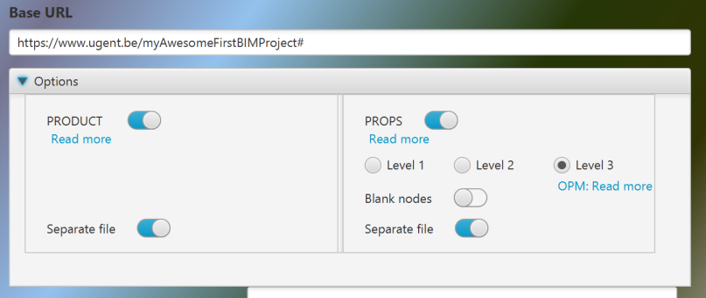
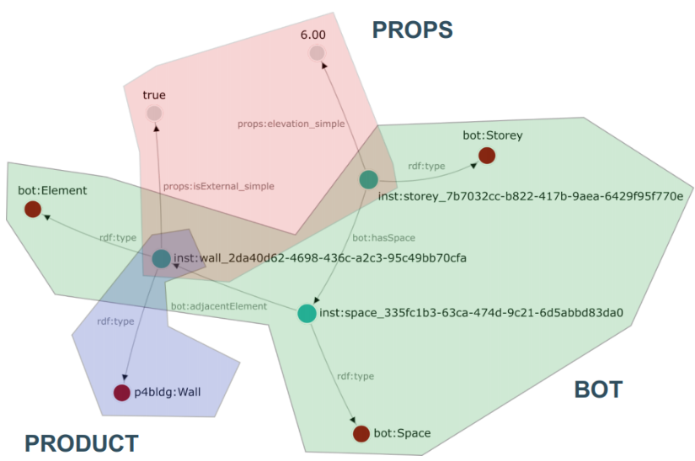
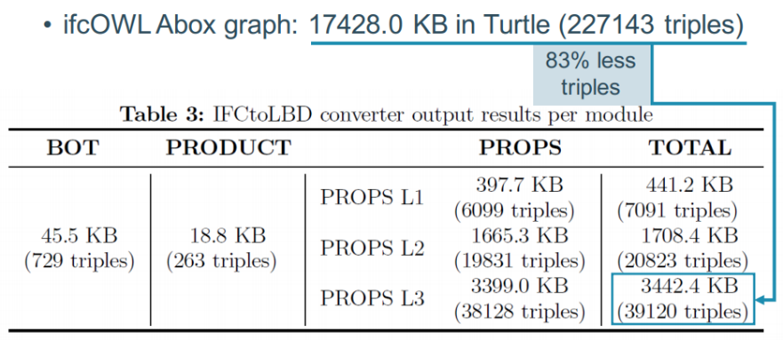
IFCtoLBD converter
https://github.com/jyrkioraskari/IFCtoLBD

Slide 57
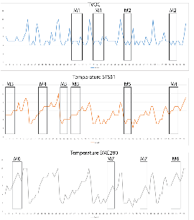
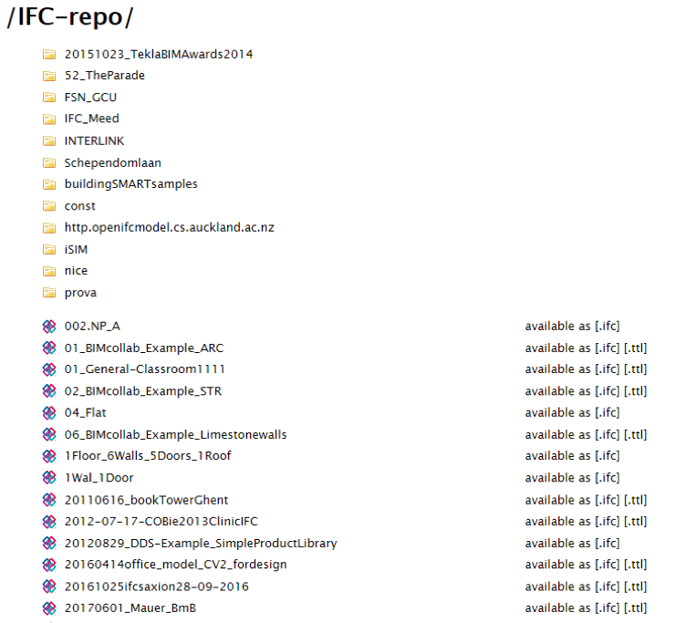
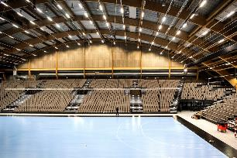

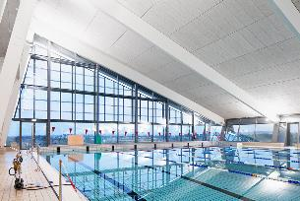
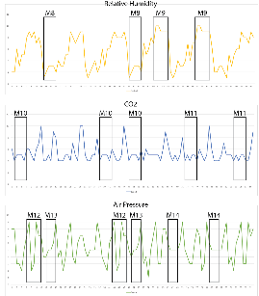

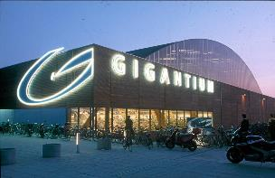
IMPLEMENTATION @GiGANTIUM DENMARK - Combination with sensor data
Repo of 531 LBD building graphs
36 million triples in total
372 bot:Building instances
3,523 bot:Zone instances
2,117 bot:Space instances
615,452 bot:Element instances
converted from http://smartlab1.elis.ugent.be:8889/IFC-repo/
to LBD using https://github.com/jyrkioraskari/IFCtoLBD

Slide 58
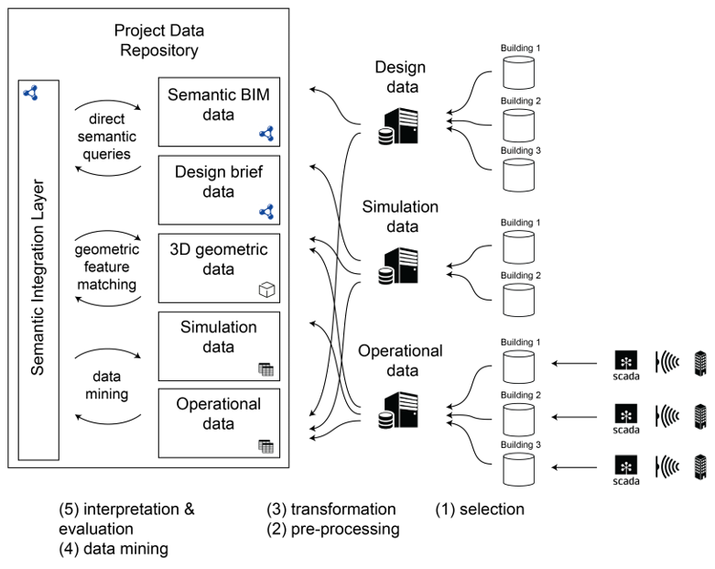
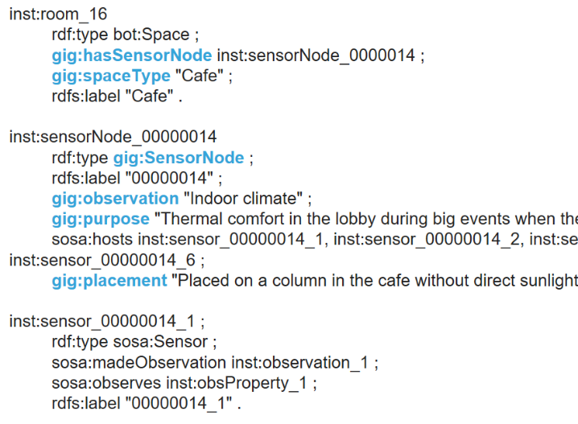
IMPLEMENTATION @GiGANTIUM DENMARK - Combination with sensor data

Slide 59
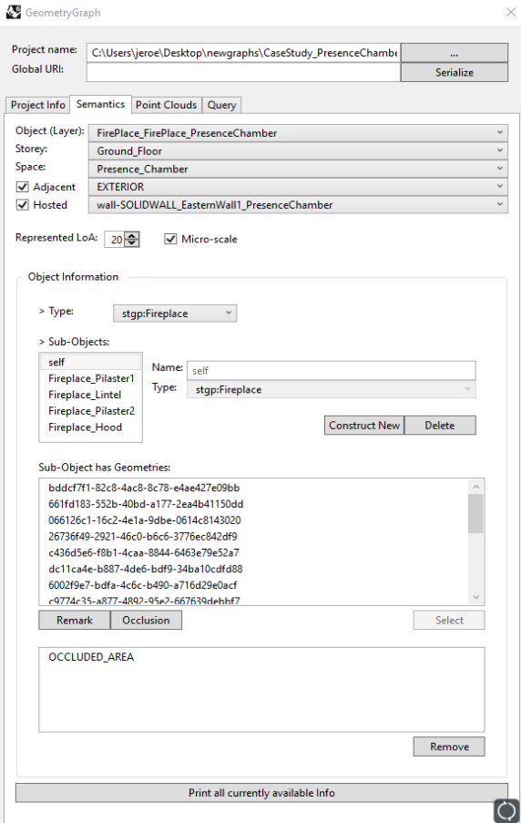
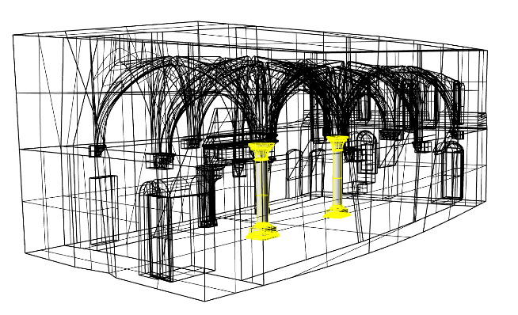
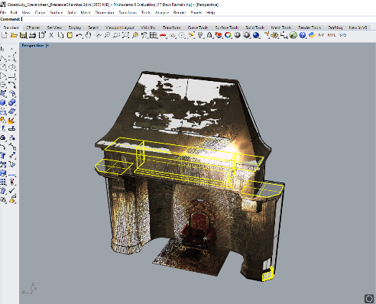

Scan to LBD Graph

Slide 60


IMPLEMENTATION AT NIRAS using OPM
Open Duplex house in Revit
Use exporter to export it to our server
Use web-viewer to show geometry + properties
Change a property in Revit to demonstrate that only the difference is stored
https://www.youtube.com/watch?v=lWoWjM-xCvY

Slide 61

Live Demos: BOT with Added Geospatial
Using BOT to interlink Ordnace Survey Ireland building data (>3.5 million buildings)
Provide a registry of authoratative URI’s for Irish building stock.
http://geovis.adaptcentre.ie/
Username: odef_adapt
Password: geo123
https://www.scss.tcd.ie/~mcglink/video/tutorial/geovis/geovis.html

Slide 62
Questions? (5 mins)

Slide 63
WHERE WE ARE HEADING AT?
Working Group !

Slide 64
sOLICITING SUPPORT
Requirements:
W3C membership is required (about 20-25 members need to express support for the WG to be created)
WG scope needs to be very strictly specified (patent policies)
WG scope needs to be very realistic
Required: soliciting support!
networking
mailing
advertising
motivating
clarifying
...

Slide 65

RENEWED CHARTER, scope and deliverables
https://w3c-lbd-cg.github.io/lbd/charter/
In scope:
Project data
building data
product data
building element properties
Out of scope:
geometry data
geospatial data
infrastructure data (bridges, roads, tunnels, rail, …)

Slide 66
How we will work
Public mailing list
IRC Channel
W3C Members only
Decisions through W3C voting procedures
Regular online calls (every 2 weeks approx.), minutes public, joint note-taking
Public GitHub organisation: https://github.com/w3c-lbd-cg
Liaison with other groups and initiatives : BuildingSMART, ETSI SAREF, OGC, AFNOR, CEN, ISO => these need to be made explicit liaisons (MOU to be signed)
External site: https://www.w3.org/community/lbd/
Internal site: https://w3c-lbd-cg.github.io/lbd

Slide 67
Thank you!
QUESTIONS?

